Slide 1



Deep Learning for Automatic Detection of Colorectal Polyps
Aprenentatge Profund 2023-25268-T1
Itxaro Aizpurua Arconada &
Rocio Gilabert Pina
06-06-2024

Slide 2
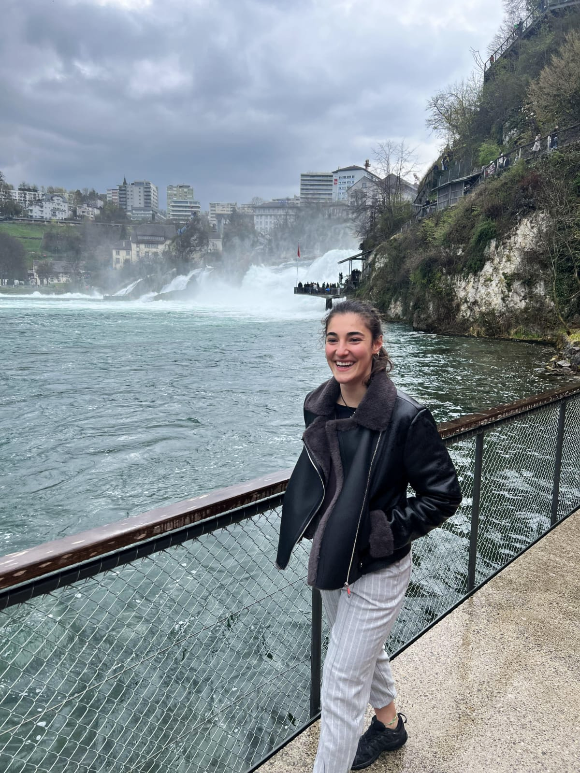
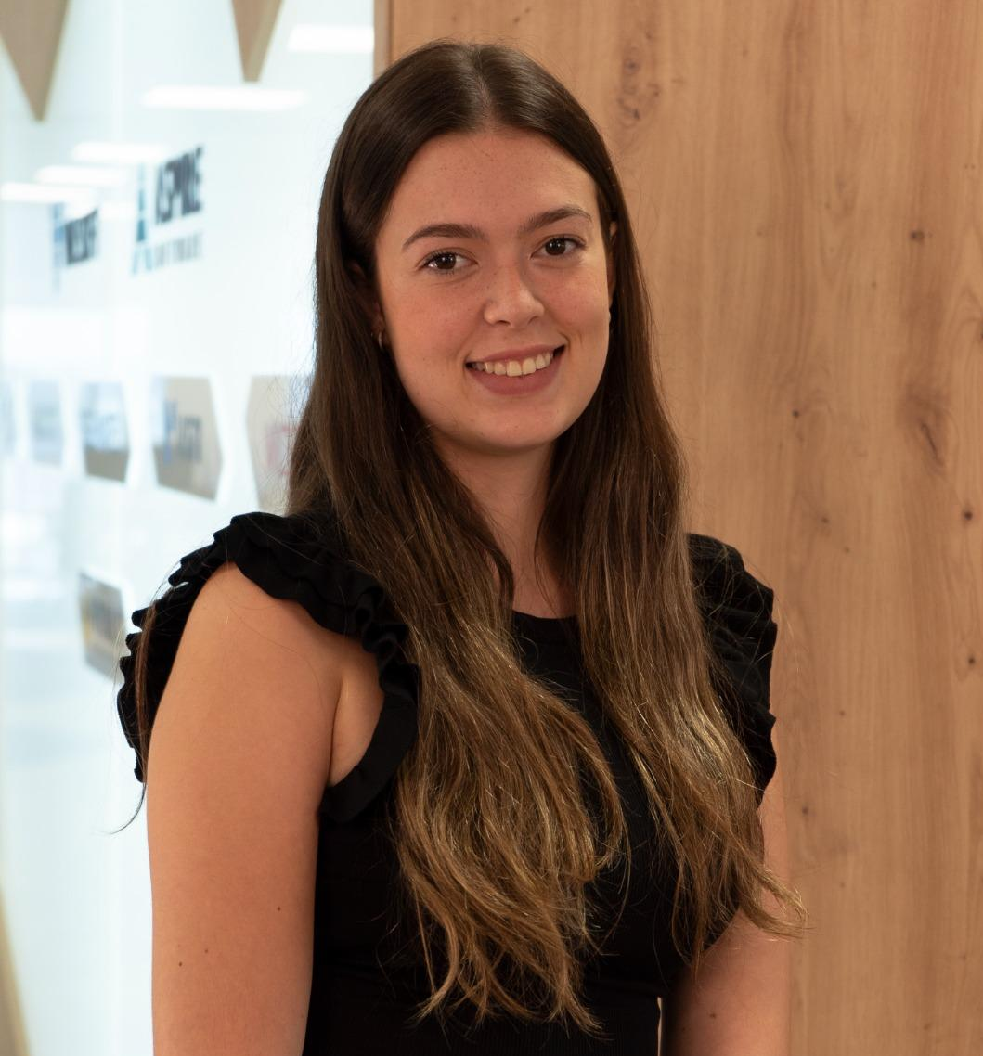

The TEAM
Itxaro AA
Rocio
Mr. Vanisher

Slide 3
INTRODUCTION
Context: Importance of early detection of colorectal polyps to prevent CRC.
Problem: 25% of polyps are overlooked during colonoscopy.
Solution: Developing an AI-based system to assist in polyp detection

Slide 4
OBJECTIVE
Create a computational method for automatic detection of colorectal polyps using deep learning.
Utilize recorded colonoscopy videos images for model training and evaluation.

Slide 5
METHODOLOGY OVERVIEW

Slide 6
METHODOLOGY OVERVIEW
Model Selection and Training
Data Collection and Preprocessing
Detection and Evaluation

Slide 7
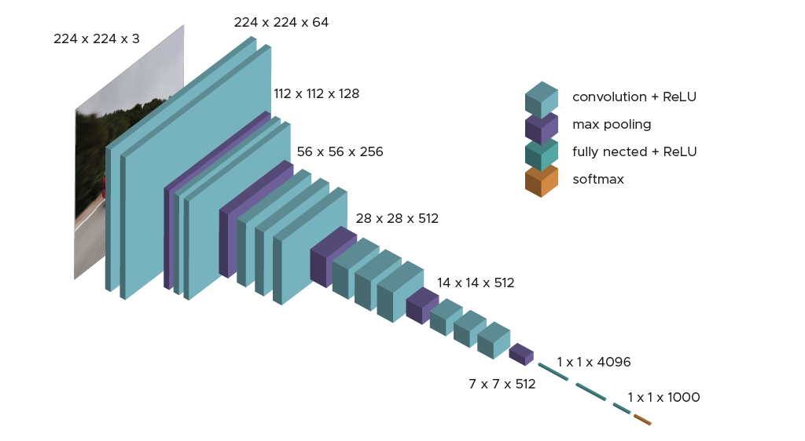
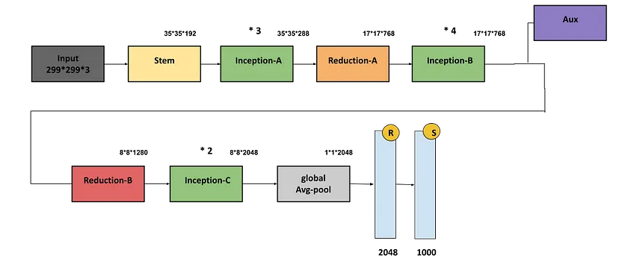
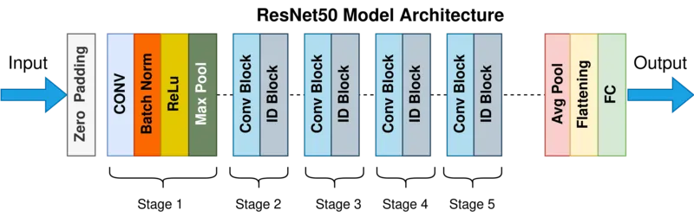
MODEL SELECTION
VGG16
INCEPTION-V3
RESNET50
Pre-trained on ImageNET
Selection Reason
Capable of fine-tuning for specific tasks

Slide 8
VGG16

Slide 9

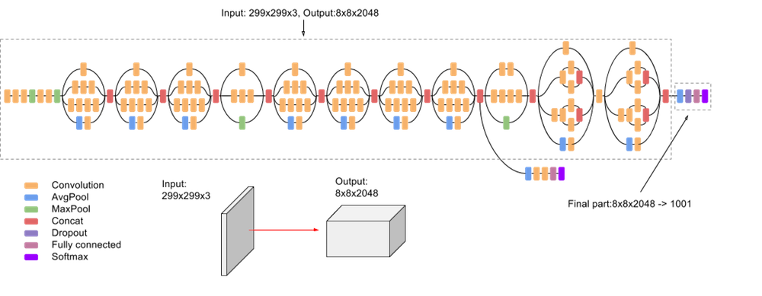
INCEPTION-V3

Slide 10
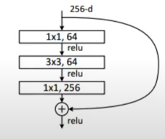
ResNet50

Slide 11
MODELS
ADVANTAGES
LIMITATIONS
High Performance
Efficient Computation
Transfer Learning
Complexity
Resource Demand

Slide 12
DATASETS OVERVIEW
Kvasir-SEG
CVC-ClinicDB
1000 images & masks (GT)
612 frames & GT
Preprocessed
01
02
/Data/kvasir-seg/
├── images/
└── masks/
/Data/
├── train/
│ ├── polyps/
│ └── non-polyps/
└── test/
├── polyps/
└── non-polyps/

Slide 13
IMPLEMENTATION

Slide 14
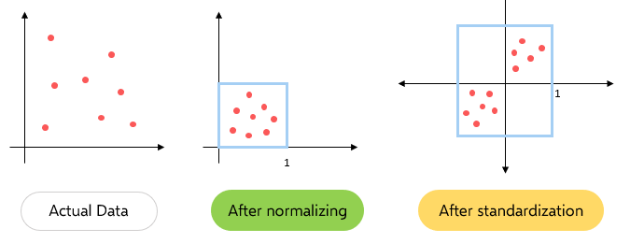
DATA PREPROCESSING
DATA LOADING
DATA SPLIT
load_data()
Test %30
Train %70
· Val %20
NORMALIZATION
𝞵 = 0
𝝈 = 1

Slide 15

TRANSFER LEARNING
Pre-trained weights from ImageNET
Fine-tuning with colonoscopy images
Benefits: Improved training efficiency, better initial performance

Slide 16
IMPLEMENTATION - V1
Transfer learning
New layers
Training
VGG16(weights='imagenet', include_top=False, input_shape=(224, 224, 3))
vgg16_model.fit(...)

Slide 17
Results Visualization

Slide 18
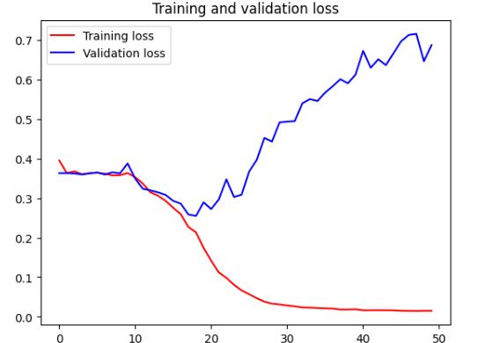
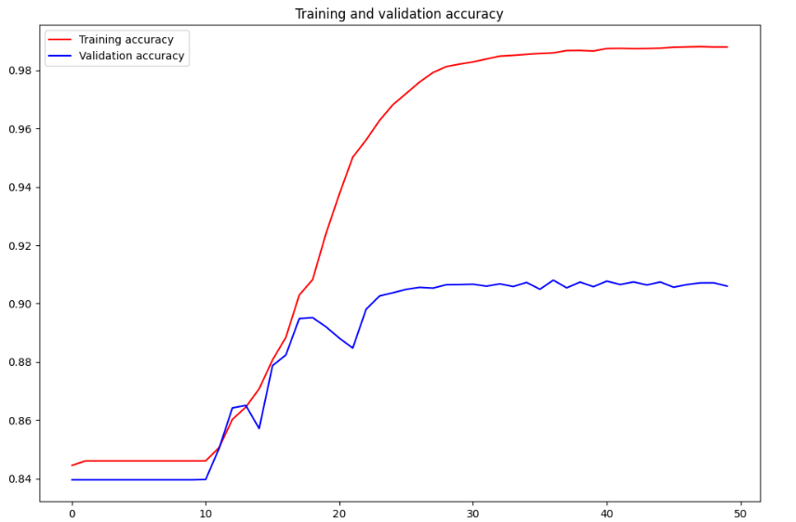
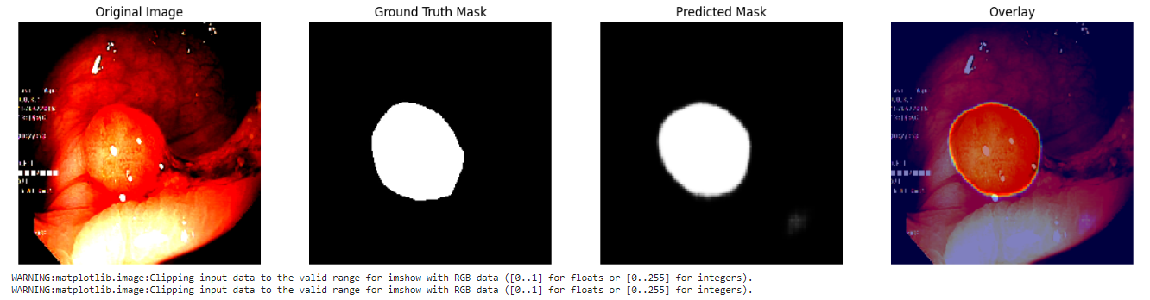
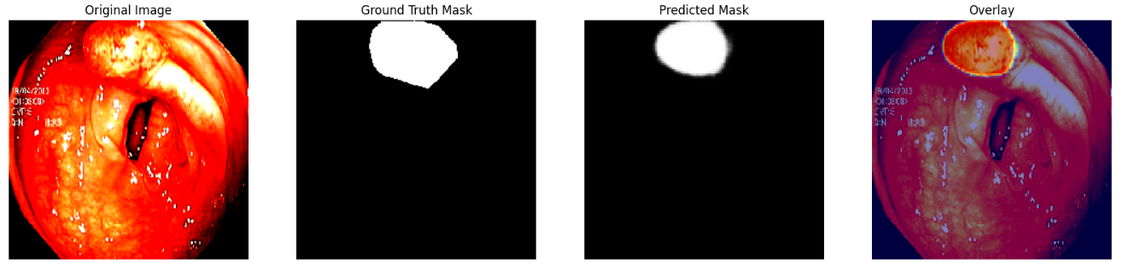
ResNet50
Accuracy
Loss
Visualization

Slide 19
PROPOSALS

Slide 20
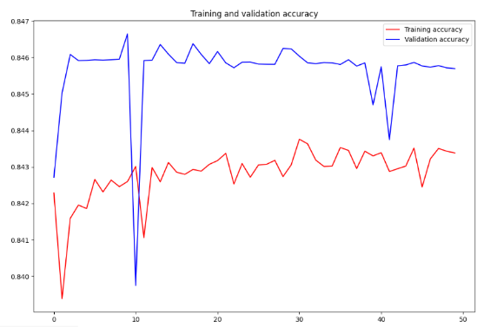
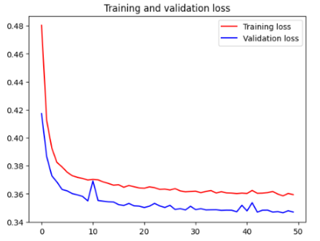
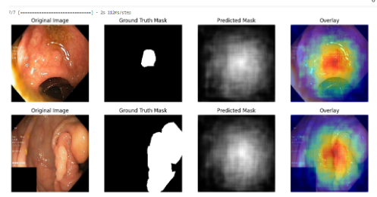
Fine-Tuning [ResNet50]
Accuracy
Loss
Visualization

Slide 21
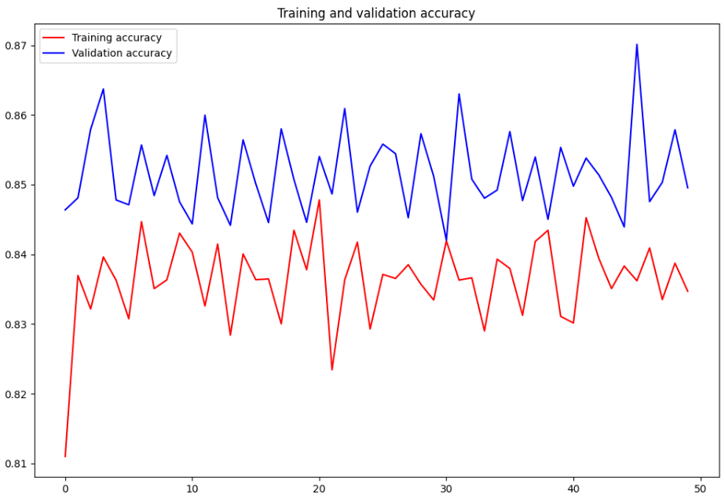
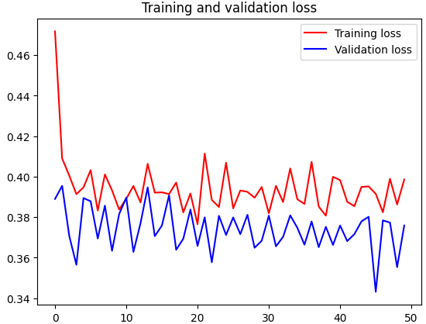
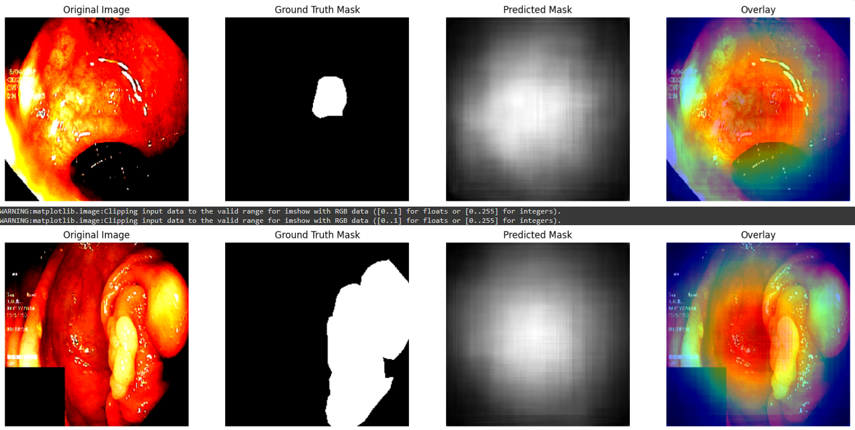
Data Augmentation [ResNet50]
Accuracy
Loss
Visualization

Slide 22
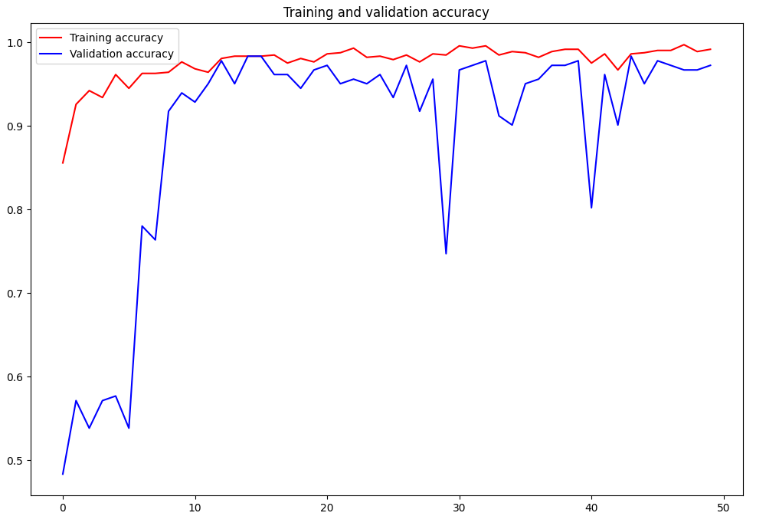
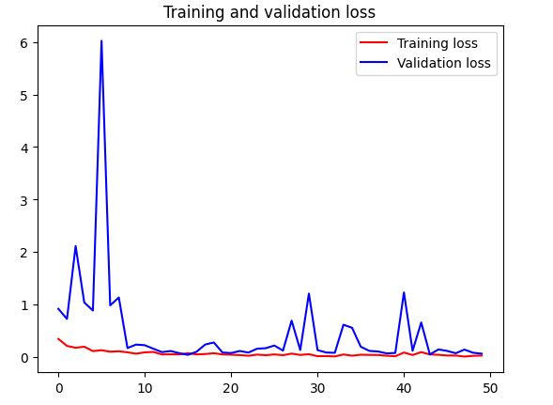
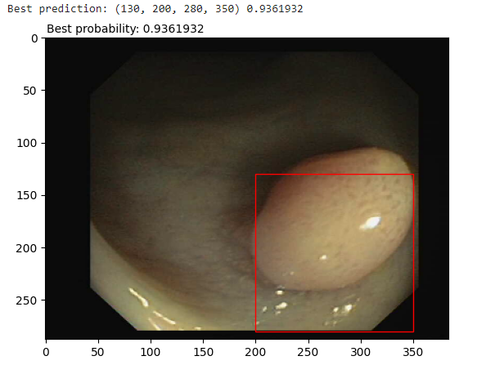
Other Dataset [InceptionV3]
Accuracy
Loss
Visualization

Slide 23
THANKS!
Do you have any questions?
Aprenentatge Profund 2023-25268-T1
Itxaro Aizpurua Arconada & Rocio Gilabert Pina
06-06-2024
Please keep this slide for attribution

